Slide 1
Client SDK FIDO IOT Design Document Diagrams
Barnes
December 2020

Slide 2
Guide
Slide 3: Figure 1 – Basic Block Diagram
Slide 4: Figure 2 – FIDO IOT Message Handling
Slide 5: Figure 3 – Transmit Message Flowchart
Slide 6: Figure 4 – Receive Message Flowchart
Slide 7: Figure 5 – Service Info Exchanges between Device and Owner Server
Slide 8: Figure 6 – Integrated Image and Execution Flow
Slide 9: Figure 7 – FDO Client SDK Block Diagram

Slide 3
SDO Library
A3
A2
ServiceInfo message handling (updated/new)
A4
Protocol Messaging Layer
(updated/new)
Persistent storage in CBOR encoded format
(new)
A1
CBOR-COSE Library
(New)
Storage
HAL
Network HAL
Crypto
HAL
TinyCBOR Library
(External - New)
OpenSSL/mbedtls
(External )

Slide 4
Transmit Message Path
msgXXX(args)
Call CBOR Library
Generate CBOR-encoded data
Send message over Network
CBOR-COSE HAL
TinyCBOR
Crypto HAL
msgXXX(args)
Receive over Network
Generate CBOR-encoded data
Return decoded message contents
Receive Message Path

Slide 5
msgXXX(args)
Encode CBOR data per message format
CBOR COSE HAL
Serialization complete?
COSE format required?/
done
No
Yes
Crypto HAL
Yes
No
TinyCBOR encode
Encode CBOR data
Transmit CBOR data

Slide 6
msgXXX(args)
Decode CBOR data from received message
CBOR COSE HAL
Recursive deserialization complete?
COSE decoding required?/
done
No
Yes
Crypto HAL
Yes
No
TinyCBOR decode
Decoded CBOR data
Pass data to SDO Library

Slide 7
SDO Library
A3
ServiceInfo message handling (updated/new)
A4
A2
Persistent storage in CBOR encoded format
(new)
Protocol Messaging Layer
(updated/new)
A1
CBOR-COSE Library
(New)
Crypto
HAL
Storage
HAL
Network HAL
TinyCBOR Library
(External - New)
OpenSSL/mbedtls
(External )

Slide 8
Module 1
Module 1
Multiple rounds of Device-to-Cloud and Cloud-to-Device
Application
Module 2
Multiple rounds of Device-to-Cloud and
Cloud-to-Device
Module 2
SDK API
Module
callback
FIDO Device Onboard
Client SDK
Multi-round Device ServiceInfo
FIDO Device Onboard
Owner
Multi-round Owner ServiceInfo

Slide 9
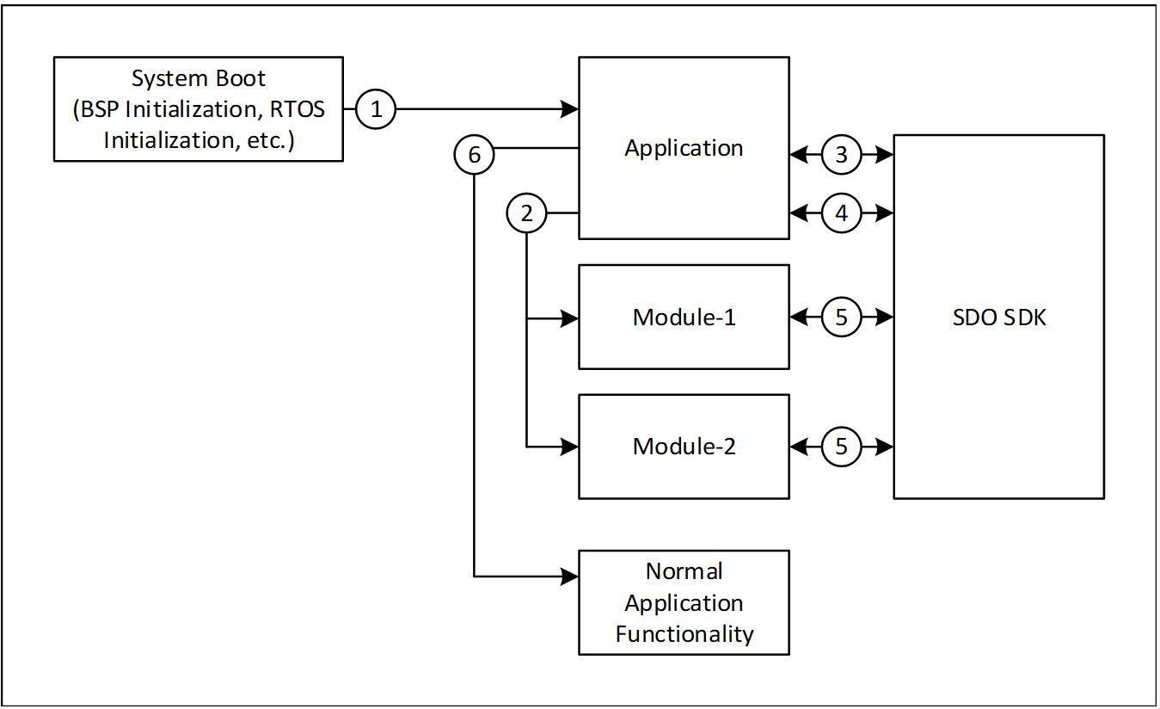
SDO
Client SDK
FDO
Client SDK

Slide 10
Customer Application
Device Management Service
FDO Client SDK
Abstraction Layer
Crypto Lib
Linux* OS
(Ubuntu* OS v20.04 LTS)
Network
Storage

